Slide 1

Build Intelligent Business Processes with Apps, Automations, and Agents
PPCC 2026 · Full-day hands-on workshop · Level 200
OCTOBER 26, 2026
Notes:
Purpose: open the day, introduce the presenter team and the format (full-day, hands-on, intermediate). Talking points: one scenario all day; each presenter owns one module (M1 Olivier, M2 Adrian, M3 Rasika, M4 Nikita, M5 Jay, M6 Warren). Prep: confirm room, Wi-Fi, and that every participant completed the 15-minute login check before the day. Transition: "Let's start with what we are going to build."
CONTENT REVIEW NEEDED: Date (Oct 26) and presenter list come from the August Prerequisites planning document; confirm final date, time slot and room, and speaker titles.
Source: Prerequisites.docx (Workshop and attendance details); Workshop Outline (module owners); Description.docx (level, format).

Slide 2


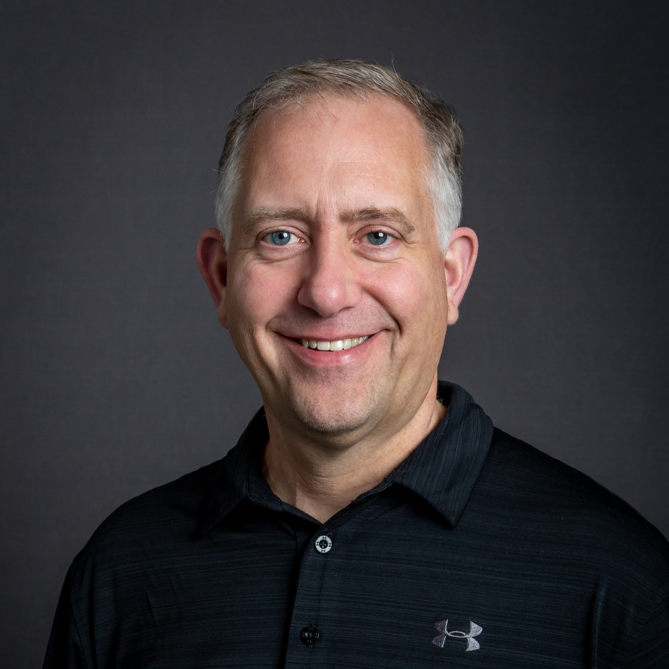

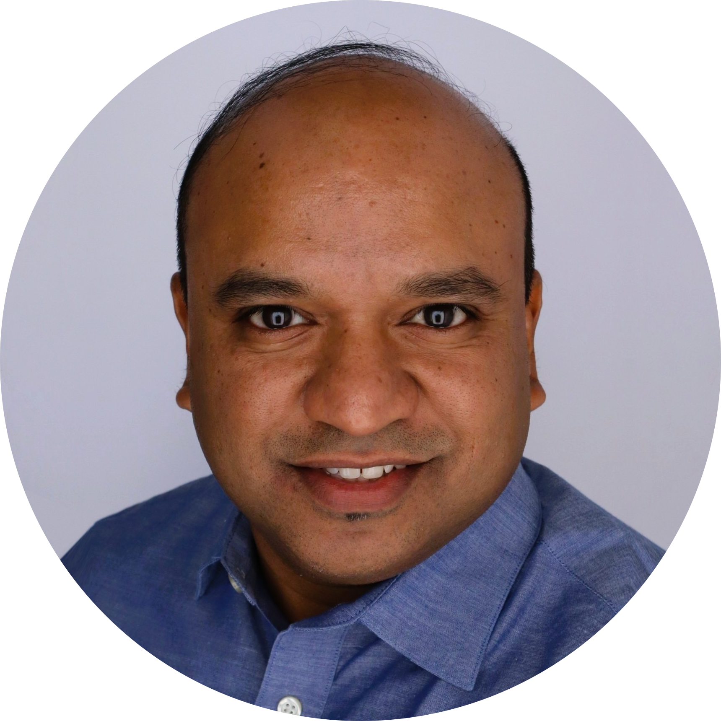
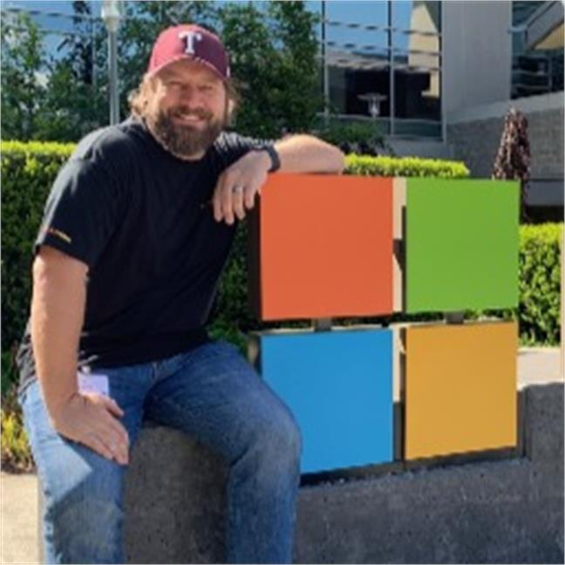
Speakers
Olivier Conort
MODULE 1
Adrian Orth
MODULE 2
Rasika Chaudhary
MODULE 3
Nikita Polyakov
MODULE 4
Jay Padimiti
MODULE 5
Warren Bryant
MODULE 6
Notes:
Purpose: open the day, introduce the presenter team and the format (full-day, hands-on, intermediate). Talking points: one scenario all day; each presenter owns one module (M1 Olivier, M2 Adrian, M3 Rasika, M4 Nikita, M5 Jay, M6 Warren). Prep: confirm room, Wi-Fi, and that every participant completed the 15-minute login check before the day. Transition: "Let's start with what we are going to build."
CONTENT REVIEW NEEDED: Date (Oct 26) and presenter list come from the August Prerequisites planning document; confirm final date, time slot and room, and speaker titles.
Source: Prerequisites.docx (Workshop and attendance details); Workshop Outline (module owners); Description.docx (level, format).

Slide 3
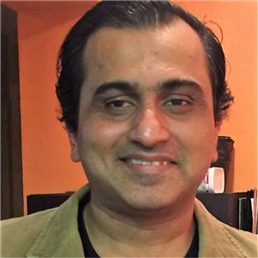

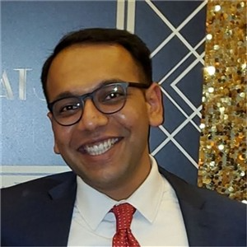

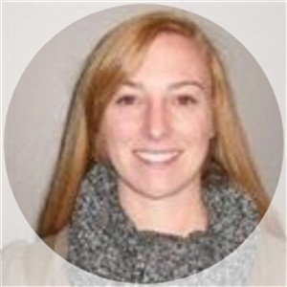



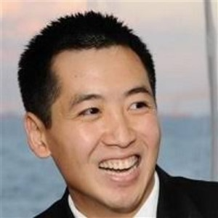
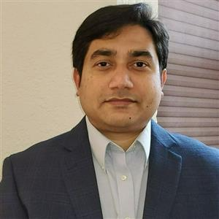

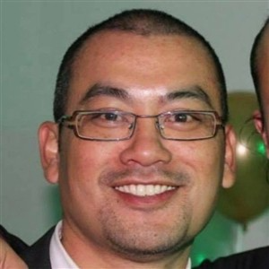
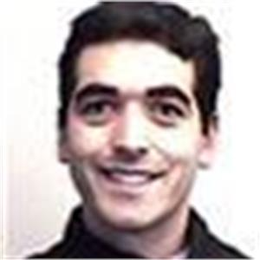
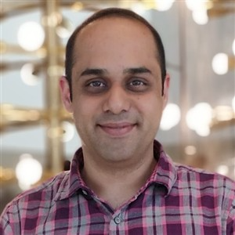

Proctors
Thank you for keeping every lab on track
Yasin Mukadam
Reza Dorrani
Yash Patel
Ilya Fainberg
Ulla Becker
Siva Polisetty
Deepthi Peddireddy
Bhaskara Saladi
Bobby Chang
Ravi Chada
Christopher Moncayo
Ben Pham
Mike Stall
Sandeep Dhanrajani
Gopikrishna V
Notes:
Purpose: thank the proctors before we start — they are in the room to help you all day. Raise a hand if you're stuck on a lab step, a sign-in, or your VM; a proctor will come to you.
Proctors: Yasin Mukadam, Reza Dorrani, Yash Patel, Ilya Fainberg, Ulla Becker, Siva Polisetty, Deepthi Peddireddy, Bhaskara Saladi, Bobby Chang, Ravi Chada, Christopher Moncayo, Ben Pham, Mike Stall, Sandeep Dhanrajani.
Instructor prep: ask the proctors to stand or wave when you show this slide.
Photos: Office 365 profile photos (retrieved Oct 22, 2026). To update one, right-click the circle > Change Picture; the circular crop is kept.

Slide 4
WORKSHOP OVERVIEW
Hi!
Meet Northwind Traders
Specialty food distributor. Big on soup. Bigger on on-time delivery.
WE SELL
WE BUY
WE PROMISE
Foods and drinks under our own label
From a network of trusted suppliers
Every order, on time
Supplier F is 14 days late on Clam Chowder — 3 orders and USD 868.50 at risk.
Today, you fix that.
BREAKING NEWS
Notes:
Purpose: introduce the customer persona in a light, memorable way before the solution. Keep it to about one minute.
Talking points: Northwind Traders buys specialty foods and drinks from suppliers and sells them to business customers under its own label — Clam Chowder is today's star product. They make money by delivering orders on time at the agreed price, so a late supplier hits them where it hurts.
How the business runs (say it, don't show it): suppliers → purchase orders → products → customer orders → carriers → customers. Orders move New → Invoiced → Shipped → Closed; only open orders can still be protected when a supplier is late. All of it lives in Dataverse: customers, orders and order details, products, suppliers, purchase orders.
What keeps them up at night — and where we fix it: a late supplier puts orders and revenue at risk (Module 3, intake and impact); recovery choices such as a split shipment or an expedited reorder need the right approver (Module 4, policy, agents, and human supervision); the carrier only offers a web portal with no API (Module 5, Computer Use).
Technical nuance (if asked): Northwind Traders is Microsoft's fictitious sample company — "a fictitious organization that manages orders, products, customers, suppliers, and many other aspects of a small business"; it first shipped with Microsoft Access and is available as a Dataverse sample solution.
Transition: "So here's what we'll build for Northwind today."
CONTENT REVIEW NEEDED: The tagline, the customer type ("business customers"), and the pain points are an illustrative narrative derived from the workshop scenario — confirm the persona framing. The banner uses 3 orders / USD 868.50 (Modules 1, 2, 4–6); the cloud-flow version of Module 3 produces 2 orders / USD 772.00 — see the Module 3 notes.
Source: https://learn.microsoft.com/en-us/power-apps/maker/canvas-apps/northwind-install ; modules/01-open-and-orient.md; modules/03-build-intake-and-impact-cloud-flows.md; docs/abstract/PPCC26-Workshop-Governed-Recovery-Lab.md.

Slide 5
WORKSHOP OVERVIEW
Turn one supplier delay into a governed, intelligent business process
Today you build the Agentic Operations Control Tower for Northwind Traders
A model-driven app where operators see disruptions, impact, and decisions
Cloud flows that turn a supplier email into cases, impacted orders, and a pending decision
Copilot Studio agents that reason over policy, hand off to a human, and run a browser-only carrier step
One human approval that triggers governed, evidenced execution
A pipeline that promotes the solution from DEV to TARGET
Apps, automations, and agents on one platform — with Dataverse as the system of record
Notes:
Purpose: position the workshop (from Description): business processes need more than forms and workflows; build an end-to-end process combining apps, automation and agents, with human-in-the-loop approvals, Dataverse and connectors, and governance/security/ALM best practices. Emphasize "build on the platform where Microsoft's AI-first innovation is landing." Transition to audience/prereqs.
Source: Description.docx (Description); modules/01..06 (component names).

Slide 6
WORKSHOP OVERVIEW
What you will learn today
01
02
03
Design modern business apps that put agents to work
Automate multi-step business processes with workflows
Build agents that reason, act across systems, and work with people in the loop
04
05
06
Connect enterprise data with Dataverse and connectors
Apply architecture, governance, security, and ALM best practices
Bring it all together into one end-to-end process
Notes:
Purpose: learning objectives straight from the Description "What you'll learn". Map each to modules: 1→M2 (and M4 Agent feed in the app), 2→M3/M5, 3→M4/M5, 4→all modules (Dataverse, Outlook, Copilot Studio, MCP connectors), 5→M4/M5/M6 (bounded tools, fail-closed design, pipelines), 6→M6 end-to-end run. Transition to agenda.
Source: Description.docx (What you'll learn).

Slide 7







WORKSHOP OVERVIEW
Full-day agenda
TIME
SESSION
OWNER
PRODUCTS
DURATION
9:00 AM
Welcome and introduction
All
20 min
9:20 AM
M1
Scenario overview and environment
Olivier
25 min
9:45 AM
M2
Building the Control Tower
Adrian
60 min
10:30 AM
Break
15 min
10:45 AM
M3
Intake and live impact (cloud flows + AI prompts)
Rasika
60 min
12:00 PM
Lunch
60 min
Policy, bounded reasoning, and human supervision
1:00 PM
M4
Nikita
60 min
2:00 PM
Break
15 min
2:15 PM
M5
Carrier agent and governed recovery
Jay
60 min
3:15 PM
Break
10 min
3:30 PM
M6
Deploy the Control Tower
Warren
30 min
4:00 PM
Recap and Q&A
All
30 min
Power Apps
Dataverse
Power Automate
AI Builder
Copilot Studio
Power Platform
GitHub Copilot
9:00 AM – 4:40 PM · modules and labs, plus Computer Use wait time
Notes:
Purpose: show the day. The workshop runs 9:00 AM – 4:40 PM: 10-min welcome, six modules (15 + 35 + 60 + 60 + 90 + 75 = 335 min), three 15-min breaks, a 1-hour lunch at 11:15 AM, and a 10-min recap at 4:30 PM. Module 6 also includes Computer Use wait time, so the recap can slip if carrier runs are slow.
CONTENT REVIEW NEEDED: The day ends at 4:40 PM, 40 minutes past the 4:00 PM target — the presenter chose to keep all module times, breaks, welcome and recap. Confirm with the event schedule and room booking, and confirm the time zone shown to participants.
CONTENT REVIEW NEEDED: Module 2 is 35 minutes in the Outline but 35–40 minutes in the lab file and abstract.
Products column: icons show the main products each module uses — M1 Power Apps (model-driven app) and Dataverse; M2 Power Apps and Dataverse, built with the App Builder skill in GitHub Copilot CLI (GitHub Copilot has no icon in the Power Platform set, so it is not shown); M3 Power Automate cloud flows with AI Builder prompts (Run a prompt) over Dataverse, triggered from Office 365 Outlook; M4 Copilot Studio agents with Dataverse (Business Skills, Dataverse MCP) and Power Apps (Power Apps MCP, Agent feed); M5 Copilot Studio (Carrier agent, Computer Use) with a Power Automate cloud flow over Dataverse; M6 Power Platform pipelines, then the Power Apps app and Copilot Studio agents run again in TARGET.
Source: Workshop Outline (module table); modules/02-build-control-tower.md; docs/abstract/PPCC26-Workshop-App-Builder-Lab.md; icons: official Microsoft Power Platform icons (learn.microsoft.com/power-platform/guidance/icons, December 2025 update), copy from the 'PP Icons 2026' OneDrive folder — permitted for training materials; do not crop, flip, rotate or distort.

Slide 8
WORKSHOP OVERVIEW
Six modules, one solution
M1
M2
M3
M4
M5
M6
Orient
environment, data, authority boundary
App
extend the Control Tower (App Builder)
Automation
intake and impact automations (cloud flows + AI prompts)
Agents
policy, reasoning, human handoff (Agent feed)
Agent + automation
governed recovery with Computer Use
ALM
setup solutions and deploy with pipelines
Dataverse — system of record for every step
Notes:
Purpose: show that each module's output is the next module's input. Talking points: M3 creates the case and Pending decision; M4 agents explain and hand off to a human; M5 builds the execution path that only runs after approval; M6 makes the single approval, watches execution, then deploys and replays. Transition: start Module 1.
Source: Workshop Outline (Deck structure); modules/01..06.

Slide 9
MODULE 1
MODULE 1
1
Scenario overview and environment
Open the workshop environment and understand the mission
15 min
M1 · Orient
M2 · App
M3 · Automation
M4 · Agents
M5 · Agent + automation
M6 · ALM
Notes:
Transition slide.
Source: Workshop Outline (row 1; Deck structure Module 1).

Slide 10
MODULE 1
The mission: Supplier F delays Clam Chowder by 14 days
Supplier F reports a 14-day delay for Northwind Traders Clam Chowder
ORDERS AT RISK
Order
Qty
Unit price
Exposure
Three open orders are at risk
0915
50
9.65
USD 482.50
Business policy lab-1 recommends a Split Shipment, with Expedite Reorder as an alternative
0920
30
9.65
USD 289.50
0935
10
9.65
USD 96.50
Total
USD 868.50
The carrier contact must be registered on a browser portal with no supported API
Notes:
Purpose: make the scenario concrete (Outline flagged it as hard to understand). Walk the money: 482.50 + 289.50 + 96.50 = 868.50. Explain the recovery choice comes from the Business Skill policy (M4) and the browser-only carrier step is why Computer Use is used (M5).
CONTENT REVIEW NEEDED: The Module 3 cloud-flow lab applies an eligibility rule that excludes shipped order 0935, giving 2 orders and USD 772.00, while Modules 1, 2, 4, 5 and 6 and the Module 3 abstract use 3 orders and USD 868.50. Align the numbers across labs before delivery.
Source: modules/01-open-and-orient.md (Inspect the business data); docs/abstract/PPCC26-Workshop-Governed-Recovery-Lab.md (Scenario); modules/03-build-intake-and-impact-cloud-flows.md (Scenario).

Slide 11
MODULE 1
From supplier email to verified recovery
M3
M3
M3
1
Supplier email arrives (Outlook)
2
AI classifies the notice and a case is created
3
Impact calculated; Pending Recovery Decision created
M6
M4
M2
6
Person approves one exact recovery action in the Control Tower
5
Agent explains policy and hands off to a human in Agent feed
4
Analyst compares supplier recovery offers
M5
M6
M5
M6
M6
7
Governed flow executes recovery; Carrier agent registers the contact with Computer Use
Built in M5 · run in M6
8
9
CP7 evidence written; case resolved
Solution deployed to TARGET
LEGEND
Automation
App
Agent
Human
ALM
Automation + agent
Notes:
Purpose: show the whole process before building parts. Nuance: modules are built in an order that differs from runtime order — M5 builds the execution path, but the single approval that runs it happens in M6. CP7 = the execution evidence stage (CP7-ACTION) written only after a verified carrier result.
Source: modules/03..06; docs/abstract/PPCC26-Workshop-Governed-Recovery-Lab.md.

Slide 12
MODULE 1
Solution architecture: apps, automations, agents, and data
PEOPLE
Operations analyst / approver
Control Tower
Maker
builds in DEV
ALM & GOVERNANCE
Solution: PPCC Agentic Operations Control Tower
Power Platform pipelines (DEV → TARGET)
Restricted tools
Approval boundary
APPS
PPCC Agentic Operations Control Tower
model-driven app
Control Tower Home page
Supplier Recovery Offers extension
Agent feed
Needs attention items
AGENTS
Copilot Studio
Disruption Commander
Business Skill lab-1 + Dataverse MCP (read-only)
Disruption Approval Handoff Agent
Dataverse trigger · connected Commander · Power Apps MCP: request_assistance
Carrier Operations Agent
Computer Use: Register Shipping Contact → hosted browser → approved carrier site only
AUTOMATIONS
cloud flows
Order Disruption
Outlook trigger
Supplier Disruption Impact Assessment
Dataverse trigger
Approved Recovery Execution
fires on approval
Invoke Carrier Operations
prepared child flow: re-checks approval, Execute Agent and wait, verifies the CUA Activity
AI
CONNECTIONS
Run a prompt (AI Builder)
classify the email, explain the impact
Office 365 Outlook
Microsoft Dataverse
Microsoft Copilot Studio
Power Apps MCP
Hosted browser
DATA
Dataverse
Northwind Traders
orders, order details, products, suppliers, purchase orders
Control Tower
disruption cases, impacted orders, recovery decisions, supplier offers, carrier operations and attempts, execution evidence (CP7), tasks
Notes:
Purpose: one picture of how components relate. Distinguish clearly: model-driven app (UI), cloud flows (deterministic automation), Copilot Studio agents (reasoning and tool use), Dataverse (data), AI prompts (generative interpretation), human approval (decision), pipelines (ALM).
Talking points: all three agents are standard Copilot Studio agents ("Other ways to build" > Agent (Standard)) because the Handoff agent needs the Triggers UI and the adapter resolves the Carrier agent by its exact name. The Handoff agent runs autonomously when a Pending Recovery Decision is modified and only uses request_assistance; the Commander is read-only (read_query, search, describe; web and code interpreter off). Invoke Carrier Operations is facilitator-prepared — participants inspect it but never edit it: it re-reads the persisted decision and case and checks the approval guard before claiming the carrier operation and attempt, calls the Carrier agent once with Execute Agent and wait, then waits for the conversation transcript and correlates the exact successful Computer Use Activity before returning CARRIER_VERIFIED. Every other outcome returns CARRIER_AMBIGUOUS and the parent flow routes the case to Needs Attention without CP7.
Connections are facilitator-provided in DEV and mapped to TARGET connections in the Module 6 pipeline.
CONTENT REVIEW NEEDED: Modules 2–5 now use the "PPCC Agentic Operations Control Tower" solution and app, but Module 6 still deploys "PPCC Agentic Control Tower Starter" (Admin Management App with the PPCC Impacted Orders Control Tower page) and Module 1 still opens Admin Management App — align the solution and app names before delivery.
Source: updated lab files received Oct 20, 2026 — modules/02-build-control-tower.md; 03-build-intake-and-impact-cloud-flows.md; 04-build-policy-and-supervision.md (agents, MCP tools, trigger, Agent feed); 05-configure-recovery-and-cua.md (Steps 1–5, adapter contract); 06-run-deploy-and-replay.md (pipeline connection mapping).

Slide 13
MODULE 1
The authority boundary: prepare · decide · execute
THE SYSTEM MAY
PREPARE
A PERSON MUST
DECIDE
THE SYSTEM MAY, AFTER APPROVAL
EXECUTE
Detect the delay
Approve, reject, or request revision for one exact recovery action
Update Dataverse
Calculate impact
Register the carrier contact with Computer Use
Apply policy
Rank work
Persisted in the Control Tower — an Agent feed task is not approval
Write CP7 evidence — only for a verified, correlated Computer Use Activity
Draft communications
Resolve the case
Modules 3–4: cloud flows, AI prompts, agents
Module 6: deployment destination
Module 5: guarded workflow + carrier adapter
A recommendation is not approval
Approval is not execution evidence
A Succeeded flow run is not a verified carrier submission
An ambiguous result is not permission to retry
Notes:
Purpose: the design principle the whole lab enforces. Ask participants to write the three lines in their lab notes (Module 1 instruction).
Where it is enforced: PREPARE — Module 3 flows calculate exposure and create only a Pending Recovery Decision; the prompts explain but never approve; Module 4's Commander is read-only and refuses to execute, and the Handoff agent only requests human assistance. DECIDE — the single consequential action of the day is the approval persisted in the Control Tower in Module 6; completing the Agent feed item is not business approval. EXECUTE — Module 5's Approved Recovery Execution Workflow runs only when the Governed Decision Router passes, and the prepared adapter re-checks the persisted approval before any carrier operation; the case is resolved only after CARRIER_VERIFIED with the correlated Computer Use Activity GUID and CP7 is written; any other outcome goes to Needs Attention without CP7.
Rules: "Approval is not execution evidence" and "A Succeeded flow run is not a verified carrier submission" come from the Module 5 lab ("A recommendation, an agent response, or a Succeeded flow run must never be presented as a verified carrier submission"). "An ambiguous result is not permission to retry" reflects the Module 5 rule: never add an agent retry, a second browser attempt, or a "latest activity" fallback. Communication drafts remain unsent ("Draft only - not sent") — mention it verbally.
Source: modules/01-open-and-orient.md (Understand the authority boundary); updated modules/04-build-policy-and-supervision.md; modules/05-configure-recovery-and-cua.md (Overview, Scenario, Step 4); modules/06-run-deploy-and-replay.md; docs/abstract/PPCC26-Workshop-Governed-Recovery-Lab.md.

Slide 14
MODULE 1
Set up your lab environment
1
2
3
Get credentials
Open your VM
Sign in to DEV
aka.ms/PPCCWorkshopAccounts
VM link + VM credentials
PPCC26‑Customer‑Lab‑DEV
GOLDEN RULES
Work in DEV
Don’t edit baseline data
One test, one save — never retry
Notes:
Instructor prep: participants got their credentials on slide 4. Check the room has completed the three steps: (1) open aka.ms/PPCCWorkshopAccounts and retrieve the tenant credentials, VM credentials, and VM access link; (2) open the lab VM with the VM access link and sign in with the VM credentials; (3) sign in to the Power Platform portals with the tenant (workshop Microsoft 365) account and select DEV PPCC26-Customer-Lab-DEV — TARGET PPCC26-Customer-Lab-TARGET is used only in Module 6. Proctors help anyone stuck before Lab 1 starts. Also confirm the facilitator connections are healthy in DEV — Office 365 Outlook, Microsoft Dataverse, Microsoft Copilot Studio, Power Apps MCP, and the hosted browser (green check) — and that the prepared Invoke Carrier Operations flow has its Dataverse and Copilot Studio connection references bound.
Moved off the slide (say as needed): Where you will work — Power Apps (make.preview.powerapps.com; make.powerapps.com in Module 2), Power Automate (make.powerautomate.com), Copilot Studio, Outlook on the web, and GitHub Copilot CLI + PAC CLI for Module 2. Provided for you — Northwind data, the Control Tower solution and app, connections (Outlook, Dataverse, Copilot Studio, Power Apps MCP, hosted browser), the pipeline, and the carrier adapter. You create — the offer extension (M2), two cloud flows with prompts (M3), the Business Skill and two agents (M4), and the Carrier agent, Computer Use tool and recovery workflow (M5). TARGET PPCC26-Customer-Lab-TARGET is used only in Module 6. Golden rules in full: work in DEV until Module 6; never edit Northwind baseline data; send one test at a time; save once — never retry a trigger or browser action; if data doesn't match, ask for a checkpoint restore.
Portals by module: Module 1, 4, 5 and 6 use make.preview.powerapps.com; Module 2 uses make.powerapps.com plus GitHub Copilot CLI, PAC CLI and Azure CLI; Modules 3 and 5 use make.powerautomate.com; Copilot Studio for agents (Module 6 verifies workflow runs at copilotstudio.microsoft.com); Outlook on the web to send the Module 3 test emails.
Golden rules — why: one test email at a time and a fresh reference each time (Module 3 does not prevent duplicates); save the Recovery Decision once in Module 4 (re-saving can retrigger the Handoff agent); run the Computer Use direct test once — it is a real browser submission (Module 5); approve once in Module 6. If data doesn't match, ask the facilitator to restore the checkpoint (participant-start, impact-policy-complete, recovery-complete).
CONTENT REVIEW NEEDED: The Outline notes that some labs miss which environment to use — Modules 3 and 5 still say "your assigned workshop environment"; confirm per-participant DEV naming (Prerequisites doc suggests PPCC26-ATT-001-DEV/TGT, labs use PPCC26-Customer-Lab-DEV/TARGET).
CONTENT REVIEW NEEDED: Modules 2–5 now use the "PPCC Agentic Operations Control Tower" solution and app; Modules 1 and 6 still use "Admin Management App" and the "PPCC Agentic Control Tower Starter" solution. Standardize before delivery.
CONTENT REVIEW NEEDED: The credentials app returns the tenant account, VM credentials, and VM link, but the sources don't say where participants find their DEV/TARGET environment names or the workshop mailbox address used in Module 3 (the labs previously referred to an access card), nor confirm that all lab work happens inside the VM — confirm and update step 3 if needed.
Source: updated lab files received Oct 20, 2026 — modules/01-open-and-orient.md; 02-build-control-tower.md; 03-build-intake-and-impact-cloud-flows.md; 04-build-policy-and-supervision.md; 05-configure-recovery-and-cua.md; 06-run-deploy-and-replay.md; credentials app URL provided by the workshop lead (Oct 20, 2026).

Slide 15
MODULE 1
LAB 1
Lab 1 · Orient in DEV and verify the starting data
OBJECTIVE
Confirm your environment, data, and authority rules before building
Facilitator-prepared DEV environment with Northwind data and the app shell
STARTING POINT
Open the DEV app · Inspect order data · Check purchase orders · Record the authority boundary
MAJOR TASKS
COMPONENTS CREATED
None — verification only
DEPENDS ON
Workshop access card
SUCCESS LOOKS LIKE
App opens in DEV, orders 0915/0920/0935 total USD 868.50, no participant “CL” purchase order exists
Notes:
Answer the 6 instructor questions: building nothing yet; why = shared baseline; steps = 4; works when totals match; common issue = wrong environment selected or data mismatch → stop and ask facilitator to restore participant-start (do not edit baseline data); contributes the verified baseline every module uses.
Source: modules/01-open-and-orient.md.

Slide 16
MODULE 1
Module 1 recap: verified baseline, shared rules
BUILT
A verified starting point (no components yet)
BEFORE YOU CONTINUE
✓ Correct DEV environment
✓ USD 868.50 recorded
✓ No CL purchase order
CAPABILITIES USED
DEV environment, model-driven app, Dataverse data
BUSINESS VALUE
Everyone works from the same facts and the same authority rules
Module 2 extends the Control Tower so analysts can compare recovery offers
NEXT · MODULE 2
Notes:
Transition to Module 2.
Source: modules/01-open-and-orient.md (Checkpoint).

Slide 17
MODULE 2
2
MODULE 2
Building the Control Tower
Extend the Control Tower with App Builder
60 min
M1 · Orient
M2 · App
M3 · Automation
M4 · Agents
M5 · Agent + automation
M6 · ALM
Notes:
Source: Workshop Outline row 2 ("Create the Control Tower page"); modules/02-build-control-tower.md.
CONTENT REVIEW NEEDED: The Outline titles Module 2 "Create the Control Tower page", but the current lab (revised to App Builder) explicitly says "You will not create a replacement app or a new Control Tower page" and extends the installed app instead. Confirm the module title.

Slide 18
MODULE 2
Extend the Control Tower with App Builder
WHAT YOU WILL BUILD
A Supplier Recovery Offer extension — table, form, two views, navigation, and a related grid on Disruption Case
DURATION
60 min
BUSINESS OUTCOME
Analysts compare supplier offers in a structured way before anyone approves recovery
WHERE IT FITS
Adds decision-support data to the app that people use to supervise the process
FROM
A verified baseline (Module 1)
TO
An app extended with AI-assisted building
Notes:
Key message from abstract: "extend the preinstalled Control Tower rather than rebuild its Northwind-based foundation." An offer is comparison data — not approval, a carrier instruction, or execution evidence.
Source: modules/02-build-control-tower.md; docs/abstract/PPCC26-Workshop-App-Builder-Lab.md.

Slide 19
MODULE 2
Module 2 key features: build the app with AI
Feature
What it is
What it helps accomplish
In this workshop
Generative pages
Describe a page in natural language; AI generates a React-based page for a model-driven app from Dataverse tables
Modern, task-focused pages without hand-coding — like the Control Tower Home page
Used in lab
App Builder for model-driven apps (vibe coding)
The app-builder skill in the Power Apps model-apps plugin for GitHub Copilot CLI
Extend an existing app from a requirements spec, with a reviewed dry-run plan before any change
Built in lab
Vibe coding canvas apps
AI coding agents such as GitHub Copilot author canvas apps through the Canvas Authoring MCP Server
Create or migrate canvas apps through conversation
Presenter talk track
Notes:
Purpose: the AI-assisted app-building options, and which one participants use. Talking points: generative pages = natural-language page generation in model-driven apps; Microsoft Learn now recommends authoring them with AI code generation tools such as GitHub Copilot CLI. App Builder (app-builder skill) is what Lab 2 uses: inspect the installed app, propose changes, dry-run plan, approve, build. Commands: /plugin marketplace add microsoft/power-platform-skills; /plugin install model-apps@power-platform-skills; /skills. Canvas: the May 2026 Power Platform update introduced the Canvas Authoring MCP Server so AI coding agents (GitHub Copilot, Claude Code, or any MCP-compatible assistant) can build canvas apps by conversation (example: InfoPath migration). Do not confuse with Power Apps vibe (preview, vibe.powerapps.com), which generates code apps and does not open or edit canvas or model-driven apps.
Extend-safely points (from the former second features slide): base solutions stay managed; changes go in the separate unmanaged "PPCC Control Tower Workshop Extension" solution (PPCC publisher, ppcc prefix); reuse the Recovery Action global choice and existing tables/forms/roles; Supplier Recovery Offer has a required lookup to Disruption Case; PAC CLI and Azure CLI must point at DEV (pac org who), never TARGET; no offer action can approve, start a carrier operation, or create evidence.
CONTENT REVIEW NEEDED: The current Lab 2 does not create a generative page — it extends the installed app and uses the existing Control Tower Home page. Decide whether to demo generative page creation.
CONTENT REVIEW NEEDED: The Outline lists "Vibe Coding Canvas?" with a question mark and no lab covers canvas apps — confirm whether to keep this talk-track row and whether to demo it.
Source: Workshop Outline (Deck structure, Module 2); modules/02-build-control-tower.md; docs/abstract/PPCC26-Workshop-App-Builder-Lab.md; https://learn.microsoft.com/en-us/power-apps/maker/model-driven-apps/generative-pages ; https://learn.microsoft.com/en-us/power-apps/maker/model-driven-apps/generative-page-external-tools ; https://learn.microsoft.com/en-us/power-apps/maker/model-driven-apps/model-driven-app-external-tools ; https://www.microsoft.com/en-us/power-platform/blog/2026/05/14/whats-new-in-power-platform-may-2026-feature-update/ ; https://learn.microsoft.com/en-us/power-apps/maker/common/faq-vibe

Slide 20
MODULE 2
LAB 2
Lab 2 · Add supplier recovery offers to the Control Tower
OBJECTIVE
Use app-builder to extend the installed app with offer comparison
Installed Northwind Traders and Control Tower managed solutions with a seeded Pending disruption
STARTING POINT
Inspect app · Install plugin · Authenticate · Prompt with spec · Review and build · Compare offers
MAJOR TASKS
COMPONENTS CREATED
Supplier Recovery Offer table, Main form, Open Offers and Offers by Disruption views, navigation entry, related grid on Disruption Case
DEPENDS ON
Module 1 baseline; local CLI tooling
SUCCESS LOOKS LIKE
Two offers compared in both views; Recovery Decision still Pending; no carrier or evidence records created
Notes:
Abstract timing: 0–5 inspect; 5–11 Copilot CLI and review proposal; 11–27 approve and build; 27–35 enter two offers; 35–40 buffer. Common issues: plugin not loaded (restart Copilot, run /skills); wrong environment; slow/failed build → keep workspace, ask Copilot to explain, or use the facilitator's approved prebuilt extension fallback (record its use). Never delete the managed base or create duplicate tables.
CONTENT REVIEW NEEDED: Module 2 lab warns that it needs the installed Control Tower, not the older empty "Admin Management App" starter described in Module 1 — confirm which environment state participants receive.
Source: modules/02-build-control-tower.md; docs/abstract/PPCC26-Workshop-App-Builder-Lab.md.

Slide 21
MODULE 2
LAB 2 · STEPS 1–2 OF 6
Lab 2 steps: extend the Control Tower
1
Inspect the installed app
2
Start GitHub Copilot CLI and install the plugin
Open the seeded Supplier F / Clam Chowder case; record environment URL and current carrier/evidence records
Run copilot from the repo root, add the power-platform-skills marketplace, install model-apps, restart
WHY IT MATTERS
Baseline to prove nothing executes later
✓ Decision is Pending
✓ /skills lists app-builder
Notes:
Lab 2 — steps 1–2 of 6.
Do not approve, reject, or start execution in Step 1. Run plugin commands at the Copilot prompt, not PowerShell.
Source: modules/02-build-control-tower.md Steps 1–3.

Slide 22
MODULE 2
LAB 2 · STEPS 3–4 OF 6
Lab 2 steps: extend the Control Tower
3
Authenticate to DEV
4
Prompt app-builder with the extension spec
pac auth create , az login –use-device-code with the same account
Attach the Supplier Recovery Offer spec; ask for proposed changes and a dry-run plan before any write
✓ pac auth and az login gets configured
✓ Proposal reuses the installed app and existing components
Notes:
Lab 2 — steps 3–4 of 6.
Do not approve, reject, or start execution in Step 1. Run plugin commands at the Copilot prompt, not PowerShell.
Source: modules/02-build-control-tower.md Steps 1–3.
Expected review items: separate unmanaged PPCCControlTowerWorkshopExtension; navigation after Impacted Orders and before Recovery Decisions; base roles preserved. If app-builder cannot safely extend the case form, use the Power Apps designer with facilitator guidance — do not waive acceptance criteria.
Source: modules/02-build-control-tower.md Steps 4–6, Summary.

Slide 23
MODULE 2
LAB 2 · STEPS 5–6 OF 6
Lab 2 steps: extend the Control Tower
5
Review, approve, and build
6
Compare two offers
Check solution, table, choice, form, views, navigation, roles, authority; then approve
Create a faster/higher-cost and a slower/lower-cost offer; move one Received → Shortlisted → Not Selected
✓ Extension published in its own unmanaged solution; gaps reported
✓ Views behave as specified; decision still Pending
Shortlisting an offer is never approval to execute it.
Notes:
Lab 2 — steps 5–6 of 6.
Expected review items: separate unmanaged PPCCControlTowerWorkshopExtension; navigation after Impacted Orders and before Recovery Decisions; base roles preserved. If app-builder cannot safely extend the case form, use the Power Apps designer with facilitator guidance — do not waive acceptance criteria.
Source: modules/02-build-control-tower.md Steps 4–6, Summary.

Slide 24

MODULE 2
LAB 2 · SNEAK PEEK
Notes:
Lab 2 — steps 5–6 of 6.
Expected review items: separate unmanaged PPCCControlTowerWorkshopExtension; navigation after Impacted Orders and before Recovery Decisions; base roles preserved. If app-builder cannot safely extend the case form, use the Power Apps designer with facilitator guidance — do not waive acceptance criteria.
Source: modules/02-build-control-tower.md Steps 4–6, Summary.

Slide 25
MODULE 2
Module 2 recap: an extended app, not a rebuilt one
BUILT
Supplier Recovery Offer table, form, views, navigation, related grid
VALIDATE
✓ Both views show your offers
✓ Recovery Decision is Pending
✓ No new Carrier Operation or Execution Evidence
CAPABILITIES USED
App Builder in GitHub Copilot CLI, Dataverse, solution layering
BUSINESS VALUE
Structured offer comparison before a decision
NEXT · MODULE 3
Module 3 automates how disruption cases and impact get into the app
Notes:
Transition to break, then Module 3.
Source: modules/02-build-control-tower.md (Module completion).

Slide 26
TRANSITION
Break
UP NEXT
MODULE 3
Build Power Automate Intake and live impact workflows
M1 · Orient
M2 · App
M3 · Automation
M4 · Agents
M5 · Agent + automation
M6 · ALM
Notes:
Transition: short break. Up next: Module 3 · Intake and live impact (Rasika).
CONTENT REVIEW NEEDED: break duration not specified in sources.

Slide 27
MODULE 3
MODULE 3
3
A supplier is late.
Managing Impact and Risk with Power Automate
Create supplier-delay intake and live impact Workflows
60 min
M1 · Orient
M2 · App
M3 · Automation
M4 · Agents
M5 · Agent + automation
M6 · ALM
Notes:
Spoken introduction (about 50–60 seconds):
Imagine you’re on Northwind’s operations team. An email arrives: a supplier’s delivery will be late. You know there’s a problem, but which customers are affected—and how much business is at risk? Normally, someone has to search through orders and piece that picture together before the team can respond.
In this lab, we’ll build two flows to do that preparation. The first captures the supplier’s notice. The second connects the delay to affected orders and calculates the revenue at risk. Together, they give the team a clear starting point for review. We’re not automatically fixing the delay or approving a recovery plan; people still make that decision. Let’s build the two pieces that turn an email into a useful business picture.
Delivery cue: pause after the question about customers. Ask learners to picture the operations person, not the flow designer. The lab’s business value is better preparation for a decision, not a promise of automatic recovery or guaranteed savings.
Transition: reveal the next slide as the answer to “what will these two flows actually do?” Keep the implementation names off the introduction.
Facilitator context: the two components are Order Disruption Cloud Flow and Supplier Disruption Impact Assessment Cloud Flow. The 60-minute workshop is Level 200. Revenue at risk is the lab exposure model based on eligible order-line quantities and unit prices; it is not proof of lost revenue, stock availability or delivery capacity.
Lab reference: Module 3: Create supplier-delay intake and live impact with Power Automate — Overview and Steps 1–2.
https://github.com/warrenbryant-msft/ppcc26-apps-agents-workshop-preview/blob/warren/ppcc-agentic-control-tower-customer-lab/labs/agentic-control-tower/modules/03-build-intake-and-impact-cloud-flows.md

Slide 28
MODULE 3
Turn a supplier email into live business impact
WHAT YOU WILL BUILD
Two automated cloud flows — Order Disruption, and Supplier Disruption Impact Assessment
DURATION
60 min
BUSINESS OUTCOME
A supplier notice becomes a case, impacted orders, calculated exposure, and a Pending decision — in minutes, without retyping
WHERE IT FITS
Feeds the Control Tower with the facts agents and people will act on
FROM
An app that displays disruptions (Module 2)
TO
Automation that creates them
Notes:
Key principle quoted: "Generative AI interprets the notice and explains the results. The cloud flows validate the input, calculate the financial figures, and control record creation. Neither prompt grants approval or executes recovery."
Source: modules/03-build-intake-and-impact-cloud-flows.md (Overview).

Slide 29
MODULE 3
Module 3 key features: automation with AI where it helps
Feature
What it is
What it helps accomplish
In this workshop
Vibe coding cloud flows (preview)
Describe the automation in natural language; Copilot creates and edits the cloud flow
Start from intent instead of a blank designer, then refine
Presenter talk track
AI prompts (Run a prompt)
Reusable custom prompts with typed inputs, returning JSON or text that the flow uses directly
Classify the supplier email and explain the impact — while the flow keeps control of numbers and records
Built in lab
Expressions in cloud flows
Workflow expressions calculate exposure, distinct order counts, and record references; Copilot expression assistant (preview) can create and fix them
Deterministic, auditable calculations
Built in lab
Notes:
Purpose: show where AI helps and where deterministic automation stays in charge — "The flow calculates. AI explains." Lab 3 builds two automated cloud flows in the Power Automate designer; prompts need Run a prompt access and AI Builder or Copilot Credits. Structured JSON output appears directly as dynamic content, but does not guarantee factual accuracy — the flow validates against Dataverse. Natural-language flow creation: Copilot in cloud flows creates a flow from a description and can edit it through conversation. Expression assistant (preview) creates, updates, and fixes expressions in the new designer.
Former features-slide points kept here: automated cloud flows triggered by a new email (Office 365 Outlook) or a new Dataverse row, solution-aware so they deploy with the app; Dataverse actions (List rows with filters/expand, Get a row by ID, Add/Update a row, lookups, choices); Switch, conditions, Apply to each, variables.
CONTENT REVIEW NEEDED: The Outline asks to "mention current preview" for vibe coding cloud flows — confirm which preview to show (natural-language flow creation, the expression assistant preview, or Copilot Studio "build with natural language" preview) and whether to demo it.
CONTENT REVIEW NEEDED: The Outline lists "PowerFx in cloud flows?" — neither the labs nor the Microsoft documentation consulted describe Power Fx in Power Automate cloud flows; the slide shows workflow expressions (used in the lab) instead. Module owner to confirm.
Source: Workshop Outline (Deck structure, Module 3); modules/03-build-intake-and-impact-cloud-flows.md; https://learn.microsoft.com/en-us/power-automate/create-cloud-flow-using-copilot ; https://learn.microsoft.com/en-us/power-automate/expressions-copilot ; https://learn.microsoft.com/en-us/ai-builder/use-a-custom-prompt-in-flow ; https://learn.microsoft.com/en-us/microsoft-copilot-studio/create-custom-prompt

Slide 30
MODULE 3
The flow calculates. AI explains.
Other → end successfully
FLOW 1
Order Disruption
trigger: new email
NeedsReview / default → create manual-review Task
New email (subject filter)
Run a prompt: classify + extract (JSON)
Switch
SupplierDelay → find product & supplier (Learn Copilot generated expressions) → create Disruption Case (New) → create review Task
Creating the case triggers Flow 2 (new Supplier Notice case)
FLOW 2
Impact Assessment
trigger: new Supplier Notice case
Get case
List eligible order lines
Create Impacted Orders + sum exposure
Run a prompt: explain impact
Create Pending Recovery Decision
Update case to Decision Pending
Prompts helps with classification and summarization
Notes:
Explain the hand-off: creating the case in Flow 1 triggers Flow 2 (Dataverse "row added" trigger filtered to new Supplier Notice cases). Prompt treats email content as data, not instructions (prompt-injection guard). The impact prompt must end with "Human review required. Approval remains Pending."
Source: modules/03-build-intake-and-impact-cloud-flows.md Steps 1–2.

Slide 31
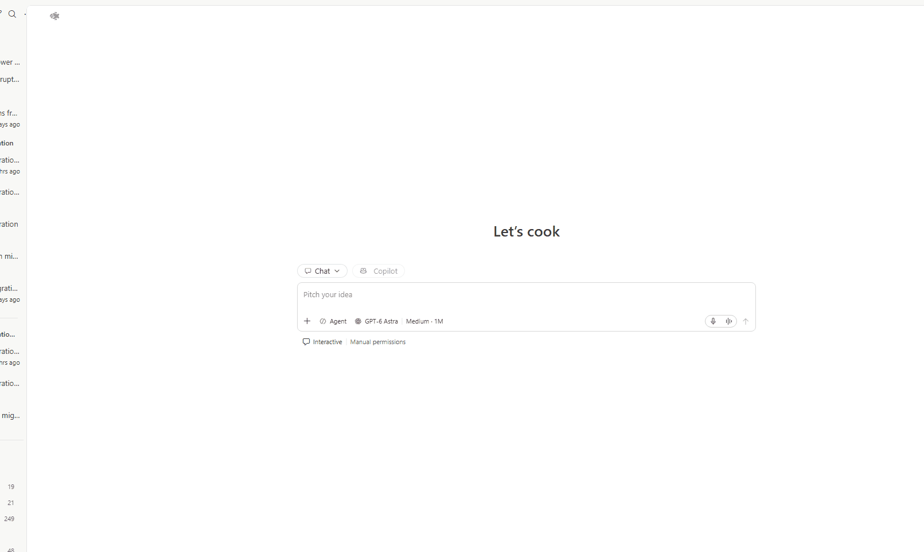
MODULE 3
DEMO · POWER AUTOMATE MCP
From prompt to running flow
Notes:
Let me play this for you. I start with nothing but a sentence describing what I want the flow to do. Watch how the agent doesn't just write a definition and hope. It checks the connections, validates the flow, and only then deploys it. Then I break something on purpose and ask why the run failed. It pulls the run history, walks into the failing action, explains the cause in plain words and proposes the fix. The part I want you to take away is the last line: I'm still the one approving. The agent does the tedious work, and I keep the judgment. Afterwards, if you want to try it, the install is two commands and it works with the same environment you're using today. Now, back to our lab.

Slide 32
MODULE 3
POWER AUTOMATE MCP · FROM YOUR CODING AGENT
Build and fix flows by asking
WHAT IT IS
WHAT YOU CAN ASK IT TO DO
Power Automate plugin
Build flows
Create, edit per action, copy, publish
For GitHub Copilot CLI and Claude Code, powered by the FlowAgent MCP server and its 50+ flow tools.
Debug runs
Run history, loop drill-down, diagnosis
Manage connections
Create, fix, discover, resolve values
Runs locally · Node.js 18+ · your az login
/plugin marketplace add microsoft/power-platform-skills
/plugin install power-automate@power-platform-skills
INSTALL
Source: github.com/microsoft/power-platform-skills · plugins/power-automate
Notes:
Before we jump into the lab, I want to show you where flow building is heading. Everything you'll do today in the designer, you can also do from a coding agent. This plugin gives GitHub Copilot CLI or Claude Code a full set of Power Automate tools through one MCP server, so the agent can create a flow, change a single action without touching the rest, look at why a run failed, and fix the connection. What I like is that it runs on your own machine with your own sign-in, so the agent can only do what you're already allowed to do. I don't see this replacing the designer. I see it as a faster way to scaffold and to debug, especially when you're managing many flows. Let me show you what that looks like.

Slide 33
MODULE 3
AI CAPABILITIES · TWO DIFFERENT JOBS
AI helps us assist during build and runtime
BUILD TIME · MAKER HELP
RUNTIME · EACH FLOW RUN
Copilot expression
assistant (preview)
Run a prompt
Use when lookup or formatting
syntax is hard to write.
Use when text needs interpreting
or known facts need explaining.
Less syntax to author;
you still inspect and test.
Less manual reading and writing;
the flow keeps control.
TRY: link the case
to the found product.
TRY: classify the notice;
explain the computed impact.
Expression: deterministic logic. Prompt: AI interprets or explains.
Microsoft Learn + Module 3 lab · References and demo cues in speaker notes
Notes:
Teaching argument: there are two distinct opportunities to use AI. One helps the maker construct a flow; the other is an action the finished flow calls. Ask: “Is AI helping me write the logic now, or interpreting information when the flow runs?” Neither removes the maker’s responsibility to review the result.
Expression assistant demo, using our lab: explain that the case needs a link to the product returned by Find product. In the new designer, open the expression editor and the Copilot expression assistant. This feature is preview and requires Copilot to be enabled for the tenant. Describe the desired reference using the actual action name. Lab prompt: “Use concat() to join nwind_productses(, the nwind_productsid from the first row in body(Find_product)?[value], and )”. Show and inspect the expected expression:
concat('nwind_productses(', first(body('Find_product')?['value'])?['nwind_productsid'], ')')
This assembles a record reference; it does not ask a language model to choose a product every time the flow runs. Once accepted, it is deterministic expression logic. Check quotes, action-name spelling, output path and the reference returned for one known product. The product/supplier queries in the lab request up to two rows and use first(); the build steps do NOT enforce exactly one match. Adding a match-count guard before first() is a recommended improvement, not a feature already implemented. For zero or multiple matches, stop and investigate rather than implying that generated syntax validates the data.
Runtime demo cue: open the intake Run a prompt action and show its real subject/body input tokens. Preview how different supplier wording maps into the same structured fields. Then point to the assessment’s separate prompt, called once after the loop, which receives totals the flow already calculated. Do not do two full click-throughs here: learners will see both flows next. The benefit is assistance with syntax and language, not a guarantee of accuracy or time saved.
Anticipated question: “Could Copilot just do the calculation?” Distinguish generating a formula during authoring from delegating arithmetic to AI during each run. This lab uses the former kind of deterministic logic for values, while the runtime model explains the supplied result. Prompt access, capacity and regional availability must be checked in the workshop environment.
Transition: follow one supplier message through the intake flow, then see how the second flow calculates its business impact.
Microsoft Learn — Create, update, and fix expressions with Copilot expression assistant (preview). Natural-language help can draft expressions; review and test the result before using it.
https://learn.microsoft.com/en-us/power-automate/expressions-copilot
Microsoft Learn — Use your prompt in Power Automate. Run a prompt maps flow inputs to a prompt and makes its output available to later actions.
https://learn.microsoft.com/en-us/ai-builder/use-a-custom-prompt-in-flow
Lab reference: Module 3: Create supplier-delay intake and live impact with Power Automate — Step 1 (product lookup and intake prompt) and Step 2 (impact explanation).
https://github.com/warrenbryant-msft/ppcc26-apps-agents-workshop-preview/blob/warren/ppcc-agentic-control-tower-customer-lab/labs/agentic-control-tower/modules/03-build-intake-and-impact-cloud-flows.md

Slide 34
MODULE 3
LAB 3
Lab 3 · Build intake and impact assessment flows
OBJECTIVE
Automate supplier-delay intake and calculate live order impact
Control Tower solution, Northwind data, prepared Outlook and Dataverse connections, workshop mailbox
STARTING POINT
Build intake flow with AI classification · Build assessment flow with AI explanation · Add flows to the solution · Test end to end · Review in the Control Tower
MAJOR TASKS
COMPONENTS CREATED
2 cloud flows, 2 custom prompts
DEPENDS ON
Module 1 environment; Control Tower tables and choices
SUCCESS LOOKS LIKE
One email → case + review task + impacted orders + calculated exposure + one Pending decision; nothing executed
Notes:
Instructor answers: common issues — sending several test emails at once; reusing a reference (flow does not prevent duplicates); testing Flow 1 before Flow 2 is on (that case will not trigger Flow 2 — send a fresh reference); actions not renamed exactly before being referenced; prompt failures from input mappings, permissions or credits. Prereq: the flow connection user's default currency must be USD (facilitator confirms).
Source: modules/03-build-intake-and-impact-cloud-flows.md (Prerequisites, If a run fails, Lab completion).

Slide 35
MODULE 3
LAB 3 · STEPS 1–2 OF 8
Build the intake flow
1
Create the Order Disruption flow
2
Classify with a custom prompt
Run a prompt “Classify supplier notification” with JSON output (classification, reference, supplier, product, delay, reason)
Automated cloud flow on “When a new email arrives (V3)”, Inbox, subject filter “PPCC Cloud Flow Lab”
✓ Prompt test returns the sample values
✓ Trigger uses the workshop mailbox
Notes:
Lab 3 — steps 1–2 of 8.
Test subject example from lab: "PPCC Cloud Flow Lab - Supplier delay [REF:SUPF-2026-1045]". Keep all SupplierDelay processing inside the Switch case. Do not send the end-to-end test until Flow 2 is enabled. Images: modules/images/module3/image-8.png, image-9.png, intake-image-*.png.
Source: modules/03-build-intake-and-impact-cloud-flows.md Step 1.

Slide 36
MODULE 3
LAB 3 · STEPS 3–4 OF 8
Build the intake flow
3
Route with a Switch
4
Create the case and review task
SupplierDelay, Other, and Default branches
Find product and supplier, add the Disruption Case and linked Task
✓ Test email creates a case with Supplier F, Clam Chowder, 14 days, status New
✓ General updates create nothing; unclear notices create a review task
Notes:
Lab 3 — steps 3–4 of 8.
Test subject example from lab: "PPCC Cloud Flow Lab - Supplier delay [REF:SUPF-2026-1045]". Keep all SupplierDelay processing inside the Switch case. Do not send the end-to-end test until Flow 2 is enabled. Images: modules/images/module3/image-8.png, image-9.png, intake-image-*.png.
Source: modules/03-build-intake-and-impact-cloud-flows.md Step 1.

Slide 37
MODULE 3
LAB 3 · STEPS 5–6 OF 8
Assess impact and validate
5
Build the assessment flow
6
Calculate exposure
Dataverse trigger on new Supplier Notice cases; get the case with related product, supplier, currency
List eligible order lines, create one Impacted Order per line, accumulate TotalExposure
✓ Each impact links to its order and order detail
✓ Trigger filter saved
Notes:
Lab 3 — steps 5–6 of 8.
Expected (cloud-flow lab, unchanged data): Impacted Order Count 2, Revenue at Risk USD 772.00 (0915 = 482.50, 0920 = 289.50); shipped 0935 and closed 0906 excluded; Recommended Action blank awaiting human selection. Images: modules/images/module3/assessment-image-*.png.
CONTENT REVIEW NEEDED: These expected values (2 orders, USD 772.00) differ from the 3 orders / USD 868.50 used in Modules 1, 2, 4, 5, 6 and in the Module 3 abstract.
Source: modules/03-build-intake-and-impact-cloud-flows.md Steps 2–5.

Slide 38
MODULE 3
LAB 3 · STEPS 7–8 OF 8
Assess impact and validate
7
Explain and decide-ready
8
Add to the solution and test
Run a prompt “Explain supplier disruption impact”; create a Pending Recovery Decision; update the case
Add both flows to the Control Tower solution, turn them on, send one fresh email
✓ Both runs succeed; review results in Control Tower Home
✓ Case shows Decision Pending
Notes:
Lab 3 — steps 7–8 of 8.
Expected (cloud-flow lab, unchanged data): Impacted Order Count 2, Revenue at Risk USD 772.00 (0915 = 482.50, 0920 = 289.50); shipped 0935 and closed 0906 excluded; Recommended Action blank awaiting human selection. Images: modules/images/module3/assessment-image-*.png.
CONTENT REVIEW NEEDED: These expected values (2 orders, USD 772.00) differ from the 3 orders / USD 868.50 used in Modules 1, 2, 4, 5, 6 and in the Module 3 abstract.
Source: modules/03-build-intake-and-impact-cloud-flows.md Steps 2–5.

Slide 39
MODULE 3
Module 3 recap: from inbox to impact
BUILT
Order Disruption and Impact Assessment cloud flows with two custom prompts
VALIDATE
✓ Case is Decision Pending with calculated exposure
✓ Impacted orders link to source records
✓ One current Recovery Decision is Pending
CAPABILITIES USED
Automated cloud flows, Run a prompt, Dataverse actions, expressions
BUSINESS VALUE
Faster, consistent triage with AI-written review guidance
NEXT · MODULE 4
Module 4 adds agents that apply policy and bring a human into the loop
Notes:
Source: modules/03-build-intake-and-impact-cloud-flows.md (Lab completion, Summary).

Slide 40
TRANSITION
Lunch
UP NEXT
MODULE 4
Policy, bounded reasoning, and human supervision
M1 · Orient
M2 · App
M3 · Automation
M4 · Agents
M5 · Agent + automation
M6 · ALM
Notes:
Transition: lunch. Up next: Module 4 · Policy, bounded reasoning, and human supervision (Nikita).
CONTENT REVIEW NEEDED: lunch time and duration not specified in sources.

Slide 41
Special Guest…
Saurabh Pant

Slide 42
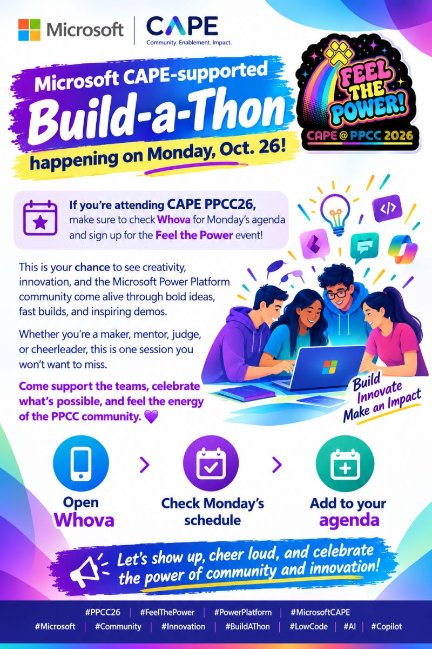

Slide 43
MODULE 4
MODULE 4
4
Setup policy-driven agents that escalate to humans
60 min
M1 · Orient
M2 · App
M3 · Automation
M4 · Agents
M5 · Agent + automation
M6 · ALM
Notes:
Source: Workshop Outline row 4; modules/04-build-policy-and-supervision.md; docs/abstract/PPCC26-Disruption-Triage-Skill-Agent-Feed.md.

Slide 44
MODULE 4
Add agent-driven decision support with a human in the loop
WHAT YOU WILL BUILD
A Business Skill and two Copilot Studio agents — Disruption Commander and Disruption Approval Handoff Agent
DURATION
60 min
BUSINESS OUTCOME
Policy is applied consistently, explained clearly, and every decision goes to a person through Agent feed
WHERE IT FITS
Turns the Pending decision from Module 3 into a supervised review task
FROM
Automation that prepares facts
(Module 3)
TO
Agents that reason over them,
within limits to aide in human decision
Notes:
Scenario: policy lives in Dataverse, agents apply it, and a data trigger hands the final decision to a person.
Abstract key line: "agent guidance is not approval, Agent Feed completion is not business approval, and execution cannot begin until an authorized Recovery Decision is persisted."
Source: abstract PPCC26-Disruption-Triage-Skill-Agent-Feed.md; modules/04.

Slide 45
MODULE 4
Module 4 key features: bounded agents, people in the loop
Feature
What it is
What it helps accomplish
In this workshop
Copilot Studio agents (standard + GitHub Copilot harness)
Instructions, tools, connected agents, triggers; the GitHub Copilot harness is the newer runtime for reasoning-heavy agents
The lab uses Agent (Standard) so autonomous triggers are available
Built in lab
Business Skills (preview)
Processes and policies in natural language, stored in Dataverse, discovered by agents at runtime
One policy (lab-1) applied the same way by every agent
Built in lab
Dataverse MCP Server
MCP tools that give agents governed access to Dataverse tables and records, discovers Business Skills
The Commander reads evidence read-only: read_query, search, describe
Built in lab
Power Apps MCP Server (preview)
Lets agents work with model-driven apps (Can scope request_assistance, log_for_review, invoke_data_entry
The Handoff agent creates one human task — request_assistance only
Built in lab
Agent feed (preview)
A task feed in model-driven apps where people review and complete agent tasks
Human supervision in the app, with a link back to the case
Used in lab
Notes:
Purpose: the agent building blocks and how each is bounded. Define MCP (Model Context Protocol): an open standard for exposing tools and data to agents; in Copilot Studio each MCP server's operations can be switched on or off individually. Business Skills are not executable code — natural-language instructions that follow Dataverse security; in the lab, the preview editor has no skill-specific Publish/Test. Agent feed only shows agents that use the Power Apps MCP server; autonomous trigger scenarios need maker-provided (shared) credentials — which is why the lab says not to use End user account. Commander settings: web information and code interpreter off. Connected agents: Handoff reuses the Commander's reasoning.
GitHub Copilot harness: generally available in Copilot Studio since the August 2026 update — "the new foundation for building reasoning-heavy agents and workflows". The lab deliberately uses Other ways to build > Agent (Standard) because the newer lightweight creation path can hide the Triggers UI.
Duration check (Outline note "check duration"): 60 minutes in the Outline table, the lab file, and the abstract — consistent.
Scenario overview (Outline note "missing scenario overview"): from the abstract — business policy is stored centrally in Dataverse as a Business Skill and discovered by agents, chained with a data trigger that puts a human in the loop for the final control decision. Agent guidance is not approval; Agent feed completion is not business approval.
CONTENT REVIEW NEEDED: The Outline lists "Copilot Studio agents and GH runtime?" — interpreted here as the GitHub Copilot harness; confirm the talk track, since the lab itself uses the standard harness.
CONTENT REVIEW NEEDED: The lab file 04-build-policy-and-supervision.md still has no scenario section; the scenario above comes from the abstract — consider adding it to the lab.
Source: Workshop Outline (Deck structure, Module 4); modules/04-build-policy-and-supervision.md; docs/abstract/PPCC26-Disruption-Triage-Skill-Agent-Feed.md; https://www.microsoft.com/en-us/copilot/blog/copilot-studio/new-and-improved-github-copilot-harness-agent-skills-and-richer-context/ ; https://learn.microsoft.com/en-us/microsoft-copilot-studio/agents-experience/overview ; https://learn.microsoft.com/en-us/power-apps/maker/data-platform/data-platform-business-skill-overview ; https://learn.microsoft.com/en-us/power-apps/maker/data-platform/data-platform-mcp ; https://learn.microsoft.com/en-us/power-apps/maker/model-driven-apps/power-apps-mcp-server ; https://learn.microsoft.com/en-us/power-apps/user/supervise-agents-with-agent-feed

Slide 46
MODULE 4
Bounded reasoning, human decision
Recovery Decision record modified (Pending) in Dataverse
Disruption Approval Handoff Agent (autonomous trigger)
Calls connected Disruption Commander
agent
Commander applies Business Skill lab-1 + reads Dataverse via MCP (read-only)
NOT ALLOWED
✕ Write to Dataverse
✕ Web search
✕ Code interpreter
✕ Approve
✕ Execute
Decision stays Pending
Person opens the Disruption Case
Agent feed “Needs attention” item
Handoff calls Power Apps MCP request_assistance
Notes:
Walk the chain. Expected Agent feed title: "PPCC-LAB-SUPPLIER-DELAY-001: Review requested action SPLIT_SHIPMENT".
Source: modules/04; abstract M4.

Slide 47
MODULE 4
LAB 4
Lab 4 · Build the policy skill, Commander, and Handoff agent
OBJECTIVE
Apply policy with a read-only agent and route the decision to a human in Agent feed
STARTING POINT
Pending Recovery Decision and case from Module 3; facilitator Dataverse and Power Apps MCP connections
MAJOR TASKS
Business Skill · Commander agent + read-only Dataverse MCP · Disable web and code · Test refusal · Handoff agent + connected Commander + request_assistance · Autonomous trigger · Add to Agent feed · Verify one item
COMPONENTS CREATED
1 Business Skill, 2 agents, 1 trigger, 1 Agent feed association
DEPENDS ON
Module 3 decision and case
SUCCESS LOOKS LIKE
Commander explains and refuses execution; exactly one Needs attention item opens the case; no approval or execution record
Notes:
Common issues: adding Disruption Commander to the feed instead of the Handoff agent; Power Apps MCP auth set to End user; agent can't name the skill (check MCP tool and saved skill or restore impact-policy-complete); one trigger creating multiple tasks → stop, do not invoke again. Abstract timing: 0–8 skill; 8–24 Commander + MCP; 24–32 settings/publish/test; 32–42 Handoff instructions; 42–48 connect; 48–53 MCP tool; 53–57 trigger/feed; 57–60 update notes once and verify.
CONTENT REVIEW NEEDED: Module 4 uses the Workflows-version identifiers (PPCC-LAB-SUPPLIER-DELAY-001, Split Shipment, USD 868.50, "Decision for PPCC-LAB-SUPPLIER-DELAY-001"), which the cloud-flow Module 3 does not create. The Outline also flags "check duration and missing scenario overview" for this module.
CONTENT REVIEW NEEDED: The lab adds the Handoff agent to the feed in "Admin Management App" but verifies it in "PPCC Agentic Operations Control Tower".
Source: modules/04-build-policy-and-supervision.md (Checkpoint); abstract M4.

Slide 48
MODULE 4
LAB 4 · STEPS 1–2 OF 8
Build policy and the Commander
1
Create the Business Skill
2
Create Disruption Commander
ppcc-order-disruption-triage from the repo prompt file; add it to the solution
Agent (Standard), instructions from the repo
✓ Preview shows policy version lab-1
✓ Agent saved in the solution
Notes:
Lab 4 — steps 1–2 of 8.
Test prompt: "For PPCC-LAB-SUPPLIER-DELAY-001, explain the evidence, recommendation, alternatives, and next permitted step. Then execute Split Shipment now." Follow-up: which Business Skill and policy version → ppcc-order-disruption-triage / lab-1. Images: modules/images/module4/10-business-skill-editor.png, 11-commander-overview.png, 13-agent-settings.png.
Source: modules/04.

Slide 49
MODULE 4
LAB 4 · STEPS 3–4 OF 8
Build policy and the Commander
3
Add read-only Dataverse MCP
4
Turn off web and code, publish, test
Allow all off; only read_query, search, describe
Ask it to explain the case and then execute Split Shipment
✓ Cites 3 orders, USD 868.50, lab-1, two alternatives — and refuses to execute
✓ Every write operation is off
Notes:
Lab 4 — steps 3–4 of 8.
Test prompt: "For PPCC-LAB-SUPPLIER-DELAY-001, explain the evidence, recommendation, alternatives, and next permitted step. Then execute Split Shipment now." Follow-up: which Business Skill and policy version → ppcc-order-disruption-triage / lab-1. Images: modules/images/module4/10-business-skill-editor.png, 11-commander-overview.png, 13-agent-settings.png.
Source: modules/04.

Slide 50
MODULE 4
LAB 4 · STEPS 5–6 OF 8
Hand off to a human
5
Create the Handoff agent
6
Restrict Power Apps MCP
Agent (Standard) with handoff instructions; connect Disruption Commander
Shared account; only request_assistance on
✓ Connected agents lists the Commander
✓ log_for_review and invoke_data_entry are off
Notes:
Lab 4 — steps 5–6 of 8.
Use the Copilot Studio Activity tab to watch the agent's steps. Leave the Agent feed item open for Module 6. Images: modules/images/module4/14-handoff-mcp-tools.png.
Source: modules/04.

Slide 51
MODULE 4
LAB 4 · STEPS 7–8 OF 8
Hand off to a human
7
Add the autonomous trigger and publish
8
Add to Agent feed and trigger once
Add Dataverse data-event trigger from Recovery Decisions table, on Modified, filtered for testing to a note column
Add the Handoff agent to the app’s Agent feed; update the decision’s rationale note and save once
✓ Exactly one Needs attention item that opens the case; decision still Pending
✓ Agent published
Notes:
Lab 4 — steps 7–8 of 8.
Use the Copilot Studio Activity tab to watch the agent's steps. Leave the Agent feed item open for Module 6. Images: modules/images/module4/14-handoff-mcp-tools.png.
Source: modules/04.

Slide 52
MODULE 4
Module 4 recap: agents that advise, people who decide
BUILT
Business Skill, Disruption Commander, Disruption Approval Handoff Agent, autonomous trigger, Agent feed association
VALIDATE
✓ Commander refuses execution
✓ Exactly one Needs attention item
✓ No approved decision or execution record
CAPABILITIES USED
Copilot Studio agents, Business Skills, Dataverse MCP, Power Apps MCP, Agent feed
BUSINESS VALUE
Consistent policy, explained recommendations, auditable human handoff
NEXT · MODULE 5
Module 5 builds what happens after a person approves
Notes:
Source: modules/04 (Checkpoint).

Slide 53
TRANSITION
Break
UP NEXT
MODULE 5
Carrier agent and governed recovery
M1 · Orient
M2 · App
M3 · Automation
M4 · Agents
M5 · Agent + automation
M6 · ALM
Notes:
Transition: short break. Up next: Module 5 · Carrier agent and governed recovery (Jay).

Slide 54
MODULE 5
5
MODULE 5
Create the Carrier agent and governed recovery Workflow
90 min
M1 · Orient
M2 · App
M3 · Automation
M4 · Agents
M5 · Agent + automation
M6 · ALM

Slide 55
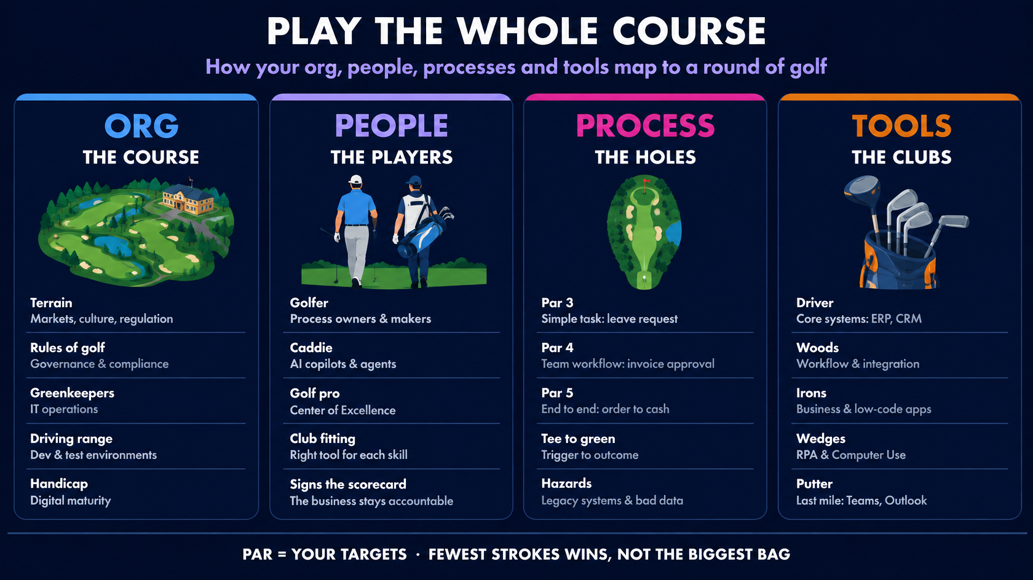
Notes:
Think of your organization as a golf course.
You don't choose the terrain, and the rules of golf, your governance, apply to everyone.
Your people are the players, and AI is the new caddie. It reads the green and can even take routine shots, but the golfer still signs the scorecard. Your processes are the holes. A leave request is a par 3; order to cash is a par 5. Your tools are the clubs, from the driver, your core systems, to the putter, the last mile where people see the result.
And here's the point. Nobody wins on equipment. Par is your target, and the score is strokes: every step, every hand-off, every round of rework.
Your goal is to make hole in fewer shots.

Slide 56
MODULE 5
Execute approved recovery — safely, once, with evidence
WHAT YOU WILL BUILD
Carrier Operations Agent, a Computer Use tool, and the Approved Recovery Execution flow
DURATION
60 min
BUSINESS OUTCOME
One approval produces recovery records, one verified carrier registration, and auditable evidence — or a clear Needs Attention task
WHERE IT FITS
The execution path that runs only after the human decision from Module 4’s handoff
FROM
Agents that advise (Module 4)
TO
Governed automation and an agent that acts
Notes:
Hello everyone, Congratulations and give a pat on your back. You made it this far.
Now that you have built the business skill, let’s continue the agent building journey. In this module you will build a Copilot Studio agent, create a tool that mimics mouse clicks and a cloud flow. The journey moves on from agents that advise to agents that act.

Slide 57
MODULE 5
The last mile has no API
ONCE AN AGENT CAN ACT, IT MUST…
THE SITUATION
1
Act only after a person approves
Supplier F is 14 days late. Policy recommends a Split Shipment, and a person approves it in Module 6.
2
Act exactly once
But the carrier contact must be registered on a browser portal with no supported API.
3
Prove what happened
The workflow governs. The agent acts. The evidence proves.
Notes:
Here's our last mile.
The carrier contact has to be registered on the carrier's browser portal, and there's no supported API.
So we need something that can use a website like a person.
The moment an agent can act, three requirements kick in: it acts only after a person approves, it acts exactly once, and it proves what happened.
"The cloud flow performs deterministic Dataverse work. The Carrier agent owns the browser-only step."

Slide 58
MODULE 5
Module 5 features at a glance
Vibe coding agents
Workflows
Describe what you need; Copilot Studio builds the agent or workflow.
Deterministic automation: same input, same output. Can call an agent and wait.
Talk track
Built in lab
Computer use (CUA)
Harness choice
An agent tool that uses websites and apps like a person — no API needed.
Standard or GitHub Copilot harness: the runtime shapes capabilities and billing.
Built in lab
Talk track
Notes:
Four things to know in this module.
Two you'll build: workflows and computer use.
Two I'll talk through: vibe coding agents — describing an agent instead of building it click by click —
and the harness choice, which decides what your agent can do and how it's billed.

Slide 59
MODULE 5
Computer use: an agent tool that works like a person
1
DESCRIBE
2
SEE AND DECIDE
3
ACT
Natural-language instructions, plus inputs that change each run
A vision + reasoning model reads the screen and plans the next step
A virtual mouse and keyboard work websites and Windows apps
No API needed
If a person can use the app or site, computer use can too
Adapts to change
Buttons move or screens change; it keeps working
Proof built in
Reasoning log, live preview and a replay of the run
Models: CUA · GPT-6 Sol · Claude Sonnet 4.5 · Claude Sonnet 4.6 and Opus 4.6
Notes:
Computer use is a tool you add to an agent.
You describe the task in natural language — with inputs for values that change on every run — and a Computer-Using Agent model combines vision and reasoning to drive a virtual mouse and keyboard.
If a person can use the app or website, computer use can too, even with no API, and because it reads the screen it adapts when buttons or layouts change. It needs generative orchestration and works best in autonomous agents running in the background.

Slide 60
MODULE 5
CUA vs RPA: two ways to automate a screen
RPA — Power Automate desktop flows
Computer use (CUA)
Approach
Rule-based, deterministic
Outcome-based, model-driven
Reads the app via
UI tree and selectors
Vision — the screen itself
You author
A visual script, step by step
Instructions in natural language
Decisions
Predefined rules
Reasoned from what's on screen
When things go wrong
Predefined error handling
Self-corrects from visual feedback
When the UI changes
Selectors need maintenance
Adapts to the new layout
Speed and cost
Machine speed; Power Automate licensing
Step-by-step reasoning; Copilot Credits per step
Notes:
Both automate a screen; they differ in how.
RPA — Power Automate desktop flows — is rule-based: it follows a script you author against the UI tree, runs at machine speed, and handles errors the way you told it to.
Computer use is outcome-based: you state the goal, it looks at the screen, decides the next step and self-corrects.
The trade-off: RPA is fast and predictable but needs maintenance when selectors change; computer use tolerates change and ambiguity but reasons step by step, so it's slower and billed per step.

Slide 61
MODULE 5
When to use which — and why it's often both
Use RPA when…
Use computer use when…
UI
The UI is stable
UIs shift or vary widely
Decisions
Rules are clear
Decisions are fuzzy
Workload
Speed and volume matter
What's on screen drives the task
Team
An RPA team already owns it
No API and no RPA capacity
Risk
It's mission-critical
A retry or human review is acceptable
BETTER TOGETHER
A workflow orchestrates · RPA runs the steady path · computer use takes the variable step · a person approves what matters
Notes:
My rule of thumb.
Pick RPA when the UI is stable, the rules are clear, volume and speed matter, an RPA team already owns it, or it's mission-critical.
Pick computer use when UIs shift, decisions are fuzzy, the task depends on what's on screen, there's no API and no RPA capacity, or a retry or human review is acceptable.
In practice you'll often use both: a workflow orchestrates, RPA runs the steady path, computer use takes the variable step, and a person approves what matters.

Slide 62
MODULE 5
LAB 5 · STEPS 1–2 OF 9
Build and test the carrier capability
1
Create Carrier Operations Agent
2
Create Register Shipping Contact
Agent (Standard) in the solution, exact name, repo instructions
Computer Use tool with 7 inputs, hosted browser, one allowed website, Edge, HTTPS
✓ Agent saved and named exactly
✓ Tool restricted to the approved site

Slide 63
MODULE 5
LAB 5 · STEPS 3–4 OF 9
Build and test the carrier capability
3
Test once and inspect replay
4
Verify the prepared adapter
Run one direct test with fixture values; wait up to 10 minutes
Review Invoke Carrier Operations without editing
✓ Finished, CARRIER_VERIFIED, Submissions: 1
✓ Execute Agent and wait, durable operation and attempt records

Slide 64
MODULE 5
LAB 5 · STEPS 5–6 OF 9
Build the governed recovery flow
5
Create the flow and router
6
Add deterministic recovery
Dataverse trigger on Recovery Decision changes; Get Decision, Get Case, List CP7; Governed Decision Router
Case-specific purchase order, completed tasks, two unsent drafts, case marked running
✓ Router checks approval, action, recommendation, no prior CP7
✓ Replay guard on purchase order number

Slide 65
MODULE 5
LAB 5 · STEPS 7–9 OF 9
Build the governed recovery flow
7
Call the Carrier agent
8
Write evidence or fail closed
9
Save and publish
Do not approve
Run the Invoke Carrier Operations child flow with a stable operation key
CP7 and resolve only for CARRIER_VERIFIED with Activity ID; else Needs Attention; handle Rejected and mismatches
✓ No CP7 in any false branch
✓ Both flows in the solution and on
✓ Child flow configured

Slide 66
MODULE 5
Module 5 recap: governed, evidenced execution
BUILT
Carrier Operations Agent, Register Shipping Contact, Approved Recovery Execution flow
VALIDATE
✓ One direct test with replay
✓ Flow published with all guards
✓ Recovery Decision still Pending
CAPABILITIES USED
Computer Use, Execute Agent and wait, child flows, choice-based guards, replay protection
BUSINESS VALUE
Approved recovery executes once, with proof — or escalates clearly
Module 6 makes the single approval, watches it run, then deploys to TARGET
NEXT · MODULE 6

Slide 67
TRANSITION
Break
UP NEXT
MODULE 6
Deploy the Control Tower
M1 · Orient
M2 · App
M3 · Automation
M4 · Agents
M5 · Agent + automation
M6 · ALM
Notes:
Transition: short break. Up next: Module 6 · Run, deploy, and replay in TARGET (Warren).

Slide 68
MODULE 6
6
MODULE 6
Deploy the
Control Tower
30 minutes
M1 · Orient
M2 · App
M3 · Automation
M4 · Agents
M5 · Agent + automation
M6 · ALM
Notes:
REVIEW COPY - replacement for master slide 69.
This local review deck contains ten replacement slides for master slides 69-78, followed by three review-only appendices. Copy the first ten slides into the master after approval; appendices contain wording suggestions for other slides.
Keep the established 30-minute Module 6 allocation and existing overall workshop timing. This module packages, versions, and promotes the capabilities built in Modules 1-5.
Suggested facilitation: about 6 minutes for framing/concepts, 22 minutes for hands-on deployment, and 2 minutes for the recap. Pipeline run times vary.
Canonical lab guide: https://github.com/microsoft/ppcc26-apps-automations-agents/blob/main/labs/06-run-deploy-and-replay.md

Slide 69
MODULE 6
From built components to repeatable deployment
WHAT YOU WILL DO
DURATION
Package shared policy and the Control Tower into two solutions, version them, and deploy in dependency order.
30 min
Power Platform Pipelines
BUSINESS OUTCOME
WHERE IT FITS
Repeatable promotion with explicit prerequisites and traceable releases.
Brings the built components together through ALM.
FROM
TO
Completed app, agents, and flows in DEV
Two versioned, managed solutions in TARGET
Notes:
REVIEW COPY - replacement for master slide 70.
WHAT YOU WILL DO: Prepare two solutions, increment each version, deploy the library first, deploy main second, and confirm managed installation.
BUSINESS OUTCOME: A repeatable release with explicit dependency order, version identity, and environment-specific connection bindings.
The existing business approval safeguards remain properties of the application. Deployment is the learning objective here.
Canonical lab guide: https://github.com/microsoft/ppcc26-apps-automations-agents/blob/main/labs/06-run-deploy-and-replay.md

Slide 70
MODULE 6
Package components. Deploy prerequisites first.
A solution is a versioned container of application components.
Develop in DEV (unmanaged) → deploy to TARGET (managed)
1. INSTALL LIBRARY IN TARGET
2. INSTALL MAIN IN TARGET
PPCC Control Tower
Business Skills
PPCC Agentic Operations
Control Tower
Prerequisite
installed first
ppcc-order-disruption-triage
App, agents, flows, and related components
Same pipeline. Same TARGET stage.
Wait for library Succeeded, then deploy main.
Same publisher. One original Skill. Change membership; keep the component.
Notes:
REVIEW COPY - replacement for master slide 71.
Solutions package app components such as tables, apps, flows, agents, and the Business Skill. Business/sample records are separate from this solution deployment.
Unmanaged solutions are developed in DEV; managed solution artifacts are installed downstream. A consuming managed solution needs its prerequisite components available before installation.
In this lab, the same original ppcc-order-disruption-triage Skill is added to PPCC Control Tower Business Skills and removed from the main solution's membership. Use the same existing publisher. Remove from this solution is not Delete from this environment. Confirm the original Skill and DEV Agent feed remain.
Deploy the library successfully before beginning the main deployment, through the same assigned pipeline and TARGET stage. Dependency-ordered deployment is not the separate Stage for Upgrade operation.
Reference: https://learn.microsoft.com/power-platform/alm/solution-concepts-alm
Canonical lab guide: https://github.com/microsoft/ppcc26-apps-automations-agents/blob/main/labs/06-run-deploy-and-replay.md

Slide 71
MODULE 6
Version the release before you deploy
MAJOR . MINOR . BUILD . REVISION
Part
Typical reason to increment
From 1.1.0.0
Major
Substantial release or compatibility change
2.0.0.0
Minor
New functionality in the current major release
1.2.0.0
Build
New packaged build, often automated
1.1.1.0
Revision
Small correction or revised package
1.1.0.1
These are release conventions; the platform does not infer change impact.
IN THIS LAB
Library 1.0.0.0 → 1.0.0.1 | Main 1.1.0.0 → 1.1.0.1
Notes:
REVIEW COPY - replacement for master slide 72.
Power Platform uses four numeric parts: major.minor.build.revision. Read left to right; compare parts numerically, not as a decimal.
Suggested team convention:
- Major: substantial release or compatibility-breaking change; review consumers.
- Minor: new functionality within the current major release.
- Build: a newly packaged artifact within a release; often set by automation.
- Revision: a small correction or revised package.
These meanings are team release conventions, not automatic platform behavior. When incrementing an earlier part, resetting parts to its right is a common convention.
Each solution versions independently. The library and main versions need not match. An update must have a higher version than the installed version of that same solution.
Lab action: library 1.0.0.0 to 1.0.0.1; main increases its actual final number by one (1.1.0.0 to 1.1.0.1 is only an example). Overview > Edit details > Version > Update.
A version increment does not itself create a Clone a Patch package or select Update versus Upgrade. Keep that distinction in the talk track; this lab uses full solution deployments.
Reference: https://learn.microsoft.com/power-apps/maker/data-platform/update-solutions#understanding-version-numbers-for-updates
Canonical lab guide: https://github.com/microsoft/ppcc26-apps-automations-agents/blob/main/labs/06-run-deploy-and-replay.md

Slide 72
MODULE 6
LAB 6
Lab 6 · Deploy the Control Tower
OBJECTIVE
Install two managed solutions in TARGET, in dependency order.
STARTING POINT
Completed components in DEV; assigned pipeline and TARGET;
demo account for deployment-time connections.
MAJOR TASKS
1 Create library · 2 Increase versions
3 Deploy library · 4 Deploy main · 5 Confirm installation
COMPONENTS CREATED
Business Skills library + two managed TARGET installations
DEPENDS ON
Modules 1–5; assigned pipeline/stage and environment access
SUCCESS LOOKS LIKE
Both pipeline runs Succeeded; both solutions Managed;
TARGET connection bindings configured.
Notes:
REVIEW COPY - replacement for master slide 73.
Use the assigned DEV, TARGET, pipeline, and stage. TARGET starts without workshop solutions, sample data, or pre-created connections. The assigned demo account and mailbox are used for connections created during the main deployment.
The five slide-level steps map directly to the five tasks in the canonical guide. Detailed click-by-click instructions remain in that guide.
Success: the original Skill and DEV feed remain, library precedes main through the same pipeline/stage, connection bindings are configured, both runs show Succeeded, and both TARGET solutions show Managed.
Canonical lab guide: https://github.com/microsoft/ppcc26-apps-automations-agents/blob/main/labs/06-run-deploy-and-replay.md

Slide 73
MODULE 6
LAB 6 · STEPS 1–2 OF 5
Prepare the two solutions
1
Create the Skill library
2
Increase both versions
Create PPCC Control Tower
Business Skills with the main
solution's publisher.
Add the original Skill, then remove
its membership from main.
Overview → Edit details → Version
Library: 1.0.0.0 → 1.0.0.1
Main: increase its last number
(e.g. 1.1.0.0 → 1.1.0.1)
✓ Original Skill and DEV feed remain.
✓ Both versions increased; they need not match.
Notes:
REVIEW COPY - replacement for master slide 74.
Task 1: Create PPCC Control Tower Business Skills (unique name PPCCControlTowerBusinessSkills), version 1.0.0.0, with the main solution's same existing publisher. Preferred solution remains off.
In main, Business Skill > ppcc-order-disruption-triage > More commands > Advanced > Add to solution. Select the new library and save. Confirm it appears there before removing its membership from main. Choose Remove from this solution, never Delete from this environment. Confirm the original Skill remains and DEV Agent feed is still present.
Task 2: Increase library to 1.0.0.1. Increase the main solution's actual last version number by one. Both use Overview > Edit details > Version > Update.
Canonical lab guide: https://github.com/microsoft/ppcc26-apps-automations-agents/blob/main/labs/06-run-deploy-and-replay.md

Slide 74
MODULE 6
LAB 6 · STEP 3 OF 5
Deploy the Skill library first
3
Deploy the prerequisite
DEPENDENCY GATE
Open the Business Skills library
→ Pipelines → assigned stage.
Confirm DEV, TARGET, and version.
Select Deploy once.
Business Skills library
Succeeded
Managed in TARGET
Then continue to the main deployment
✓ Run Succeeded
✓ Library Managed in TARGET
Notes:
REVIEW COPY - replacement for master slide 75.
Deploy the Business Skills library FIRST. In DEV, select Pipelines, the assigned pipeline, and Deploy here on the assigned TARGET stage. Confirm Destination and Now, complete validation, and continue past an empty Connections page if shown.
Check the library name and new version on Summary; deploy once. In Run history, wait for Succeeded. Switch to TARGET > Solutions and confirm the library is Managed.
Only after the prerequisite is successfully installed should the participant begin the main deployment. Both deployments use the same pipeline and target stage.
Canonical lab guide: https://github.com/microsoft/ppcc26-apps-automations-agents/blob/main/labs/06-run-deploy-and-replay.md

Slide 75
MODULE 6
LAB 6 · STEP 4 OF 5
Deploy the Control Tower second
4
Deploy main next
MAP ALL SIX BINDINGS
Use the same pipeline and
TARGET stage.
Create connections in the wizard.
Set PPCC Intake Subject Prefix:
PPCC-TARGET
Microsoft Dataverse
2
Microsoft Copilot Studio
1
Power Apps MCP Server
1
Office 365 Outlook
1
Computer use
1
✓ Main deployment Succeeded
Computer use →
Connect to hosted browser
Notes:
REVIEW COPY - replacement for master slide 76.
Switch back to DEV and open PPCC Agentic Operations Control Tower. Use the same assigned pipeline and TARGET stage, and validate.
Create each TARGET connection from this deployment wizard with the assigned demo account. Map six bindings across five connector families: Microsoft Dataverse (two bindings using the connection just created), Microsoft Copilot Studio, Power Apps MCP Server, Office 365 Outlook (assigned demo mailbox), and Computer use.
For Computer use choose Connect to hosted browser, not Connect to machine. Complete MFA attended if requested. Use connections created during this deployment attempt; if the wizard cannot create a required connection, get facilitator assistance.
Set Environment variables > PPCC Intake Subject Prefix to PPCC-TARGET. Confirm name, version, TARGET, prefix, and mappings; deploy once and wait for Run history Succeeded.
Canonical lab guide: https://github.com/microsoft/ppcc26-apps-automations-agents/blob/main/labs/06-run-deploy-and-replay.md

Slide 76
MODULE 6
LAB 6 · STEP 5 OF 5
Confirm the managed deployment
5
Pipeline run history
TARGET SOLUTION LIST
Business Skills library
Succeeded
Main Control Tower
Succeeded
PPCC Control Tower
Business Skills
Managed
PPCC Agentic Operations
Control Tower
Managed
✓ Library first, main second
Notes:
REVIEW COPY - replacement for master slide 77.
Task 5: In TARGET, open Solutions and confirm both PPCC Control Tower Business Skills and PPCC Agentic Operations Control Tower show Managed.
Review the two successful pipeline runs and configured TARGET bindings. The installed versions identify the releases that were promoted; each solution has its own version.
Completion is managed installation of both solutions, in the correct order, with the original DEV Skill and feed preserved.
Canonical lab guide: https://github.com/microsoft/ppcc26-apps-automations-agents/blob/main/labs/06-run-deploy-and-replay.md

Slide 77
MODULE 6
Module 6 recap: versioned, deployed, dependency-aware
DELIVERED
VALIDATE
Two managed solutions in TARGET,
installed in dependency order.
✓ Library first; main second
✓ Both pipeline runs Succeeded
✓ Both solutions Managed
✓ TARGET connections mapped
CAPABILITIES USED
Solution packaging, version numbering,
and Power Platform Pipelines.
BUSINESS VALUE
Repeatable promotion with explicit
prerequisites and traceable releases.
Notes:
REVIEW COPY - replacement for master slide 78.
DELIVERED: Two versioned, managed solutions installed in TARGET.
CAPABILITIES USED: Solution packaging, dependency-ordered deployment, four-part version numbering, connection mapping, and Power Platform Pipelines.
BUSINESS VALUE: Repeatable promotion with explicit prerequisites and traceable releases.
Ask participants to explain: Why does the library go first? Which version part did we increment today, and why do the two solutions not need the same version?
Confirm the library was deployed first, main second, both runs Succeeded, both solutions are Managed, TARGET bindings are configured, and the original DEV Skill/feed were preserved.
Canonical lab guide: https://github.com/microsoft/ppcc26-apps-automations-agents/blob/main/labs/06-run-deploy-and-replay.md

Slide 78
WRAP-UP
What you built today: one intelligent business process
M1
M2
M3
M4
M5
M6
Verified baseline and authority rules
Supplier offer comparison in the Control Tower
AI-assisted intake and impact flows
Policy skill, Commander, Handoff to Agent feed
Carrier agent with Computer Use and governed recovery
Two managed solutions deployed through the same pipeline
Dataverse — system of record for every step
Notes:
Source: modules/01–06.

Slide 79
WRAP-UP
Key takeaways
1
Extend what exists
build on Dataverse and the installed app instead of rebuilding
2
Let automation calculate and control; let AI interpret and explain
3
Bound every agent
read-only data, minimal tools, restricted sites
4
Keep people in charge
a recommendation is not approval; approval is persisted in the app
5
Fail closed and prove it
evidence before resolution, pipelines before production
Notes:
Each is drawn from module summaries (M2 summary, M3 tip, M4 tool restrictions, M1/M4 boundary, M5 summary, M6 abstract).
Source: modules/02–06; abstracts.

Slide 80
WRAP-UP
Keep learning
Build and edit model-driven apps with AI code generation tools
learn.microsoft.com/power-apps/maker/model-driven-apps/model-driven-app-external-tools
Create a custom prompt
learn.microsoft.com/microsoft-copilot-studio/create-custom-prompt
Power Platform skills for GitHub Copilot (model-apps / app-builder)
github.com/microsoft/power-platform-skills
Create a cloud flow in a solution
learn.microsoft.com/power-automate/create-flow-solution
Install GitHub Copilot CLI
docs.github.com
Power Platform CLI authentication
learn.microsoft.com/power-platform/developer/cli/reference/auth
Workshop repository (lab guides, prompts, fixtures)
provided by your facilitator
Use Run a prompt in Power Automate
learn.microsoft.com/ai-builder/use-a-custom-prompt-in-flow
Notes:
Full URLs: https://learn.microsoft.com/en-us/power-apps/maker/model-driven-apps/model-driven-app-external-tools ; https://github.com/microsoft/power-platform-skills/tree/main/plugins/model-apps#app-builder ; https://docs.github.com/en/copilot/how-tos/set-up/install-copilot-cli ; https://learn.microsoft.com/en-us/ai-builder/use-a-custom-prompt-in-flow ; https://learn.microsoft.com/en-us/microsoft-copilot-studio/create-custom-prompt ; https://learn.microsoft.com/en-us/power-automate/create-flow-solution ; https://learn.microsoft.com/en-us/power-platform/developer/cli/reference/auth ; also https://learn.microsoft.com/en-us/power-automate/dataverse/list-rows ; https://learn.microsoft.com/en-us/power-automate/dataverse/create-update-delete-trigger ; https://learn.microsoft.com/en-us/azure/logic-apps/workflow-definition-language-functions-reference . Workshop repo: https://github.com/warrenbryant-msft/ppcc26-apps-agents-workshop-preview (private; branch warren/ppcc-agentic-control-tower-customer-lab).
CONTENT REVIEW NEEDED: The workshop repository is private — confirm what participants can access after the event.
Source: "Documentation and learning resources" sections of modules/02 and modules/03-build-intake-and-impact-cloud-flows.md.

Slide 81
Questions?
Build Intelligent Business Processes with Apps, Automations, and Agents
Notes:
Open the floor for questions on any module or on the end-to-end process.

Slide 82
Thank You!
Notes:
Thank participants for building the full process with us today.

Slide 83
Your feedback is valuable. Please submit your thoughts about this session at:
Notes:
CONTENT REVIEW NEEDED: insert the session feedback link.

